Slide 1
UML Diagrams

Slide 2
Why UML Class Diagrams
A class diagram depicts classes and their interrelationships
Used for describing structure and behavior in the use cases
Provide a conceptual model of the system in terms of entities and their relationships
Used for requirement capture, end-user interaction
Detailed class diagrams are used for developers

Slide 3
Identifying UML Classes
Based on the system descriptions, using object-oriented analysis (OOA), identify classes, attributes, and operations
For example, nouns / objects that share common properties and are used to enable system functionality become classes
Other nouns related to class nouns become class attributes
Verbs related to class nouns become class operations
After identifying classes, identify applicable relationships
For example, identify cases where objects of one class reference (are associated with) the objects of another
Also identify shared (inherited) behavior between classes.

Slide 4
Classes
A class is a description of a set of objects that share the same attributes, operations, relationships, and semantics.
Graphically, a class is rendered as a rectangle, usually including its name, attributes, and operations in separate, designated compartments.
ClassName
attributes
operations

Slide 5
Class Names
ClassName
The name of the class is the only required tag in the graphical representation of a class. It always appears in the top-most compartment.
attributes
operations

Slide 6
Class Attributes
Person
name : String
address : Address
birthdate : Date
ssn : Id
An attribute is a named property of a class that describes the object being modeled.
In the class diagram, attributes appear in the second compartment just below the name-compartment.

Slide 7
Class Attributes (Cont’d)
Attributes are usually listed in the form:
attributeName : Type
A derived attribute is one that can be computed from other attributes, but doesn’t actually exist. For example, a Person’s age can be computed from his birth date. A derived attribute is designated by a preceding ‘/’ as in:
/ age : Date
Person
name : String
address : Address
birthdate : Date
/ age : Date
ssn : Id

Slide 8
Class Attributes (Cont’d)
Person
+ name : String
# address : Address
# birthdate : Date
/ age : Date
- ssn : Id
Attributes can be:
+ public
# protected
- private
/ derived

Slide 9
Class Operations
Person
name : String
address : Address
birthdate : Date
ssn : Id
eat
sleep
work
play
Operations describe the class behavior and appear in the third compartment.

Slide 10
Depicting Classes
When drawing a class, you needn’t show attributes and operation in every diagram.
Person
Person
Person
name : String
birthdate : Date
ssn : Id
Person
name
address
birthdate
eat()
sleep()
work()
play()
Person
eat
play

Slide 11
Class Responsibilities
A class may also include its responsibilities in a class diagram.
A responsibility is a contract or obligation of a class to perform a particular service.
SmokeAlarm
Responsibilities
-- sound alert and notify guard station
when smoke is detected.
-- indicate battery state

Slide 12
Relationships
In UML, object interconnections (logical or physical), are modeled as relationships.
There are three kinds of relationships in UML:
  dependencies
  generalizations
  associations

Slide 13
Dependency Relationships
A dependency indicates a semantic relationship between two or more elements. The dependency from CourseSchedule to Course exists because Course is used in both the add and remove operations of CourseSchedule.
CourseSchedule
Course
add(c : Course)
remove(c : Course)

Slide 14
Generalization Relationships
Person
A generalization connects a subclass to its superclass. It denotes an inheritance of attributes and behavior from the superclass to the subclass and indicates a specialization in the subclass of the more general superclass.
Student

Slide 15
Generalization Relationships (Cont’d)
UML permits a class to inherit from multiple superclasses, although some programming languages (e.g., Java) do not permit multiple inheritance.
Student
Employee
TeachingAssistant

Slide 16
Association Relationships
If two classes in a model need to communicate with each other, there must be link between them.
An association denotes that link.
Student
Instructor

Slide 17
Association Relationships (Cont’d)
We can indicate the multiplicity of an association by adding multiplicity adornments to the line denoting the association.
The example indicates that a Student has one or more Instructors:
Student
Instructor
1..*

Slide 18
Associations (cont.)
  Multiplicity Indicators
Exactly one | 1
Zero or more (unlimited) | * (0..*)
One or more | 1..*
Zero or one (optional association) | 0..1
Specified range | 2..4
Multiple, disjoint ranges | 2, 4..6, 8

Slide 19
Association Relationships (Cont’d)
The example indicates that every Instructor has one or more Students:
Student
Instructor
1..*

Slide 20
Association Relationships (Cont’d)
We can also indicate the behavior of an object in an association (i.e., the role of an object) using rolenames.
teaches
learns from
Student
Instructor
1..*
1..*

Slide 21
Association Relationships (Cont’d)
We can also name the association.
membership
Student
Team
1..*
1..*

Slide 22
Association Relationships (Cont’d)
We can specify dual associations.
member of
Student
Team
1..*
1..*
1
president of
1..*

Slide 23
Association Relationships (Cont’d)
We can constrain the association relationship by defining the navigability of the association. Here, a Router object requests services from a DNS object by sending messages to (invoking the operations of) the server. The direction of the association indicates that the server has no knowledge of the Router.
Router
DomainNameServer

Slide 24
Association Relationships (Cont’d)
Associations can also be objects themselves, called link classes or an association classes.
Registration
modelNumber
serialNumber
warrentyCode
Product
Warranty

Slide 25
Association Relationships (Cont’d)
We can model objects that contain other objects by way of special associations called aggregations and compositions.
An aggregation specifies a whole-part relationship between an aggregate (a whole) and a constituent part, where the part can exist independently from the aggregate. Aggregations are denoted by a hollow-diamond adornment on the association.
Car
Engine
Transmission

Slide 26
Association Relationships (Cont’d)
A composition indicates a strong ownership and coincident lifetime of parts by the whole (i.e., they live and die as a whole). Compositions are denoted by a filled-diamond adornment on the association.
Window
Scrollbar
1
1
Titlebar
1
1
Menu
1
1 .. *

Slide 27
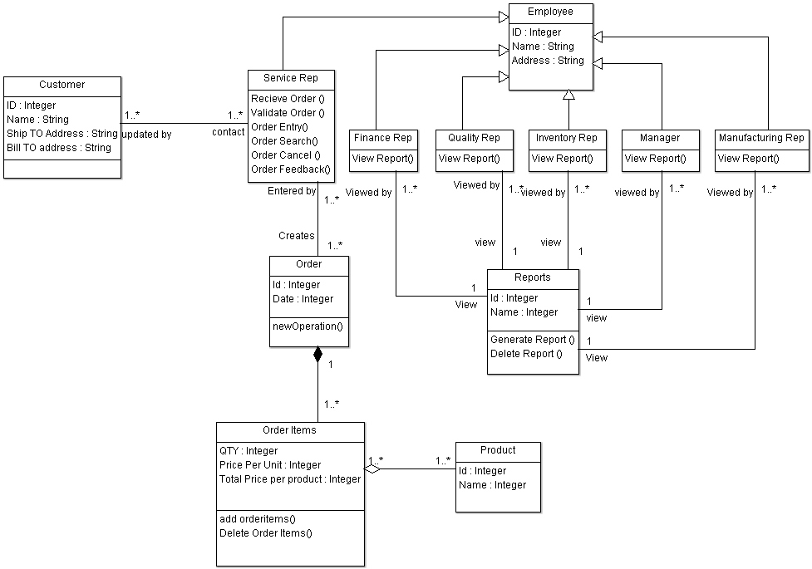

Slide 28
System models
(or)
Object Oriented Analysis and Design

Slide 29
What is a System Model
These models are graphical representations that describe the problem to be solved and the system that is to be developed
Graphical notations are often more understandable than detailed natural descriptions of the system
They are also an important bridge between the analysis and design stages

Slide 30
System modelling
System modelling helps the analyst to understand the functionality of the system and models are used to communicate with customers.
Different models present the system from different perspectives
  External perspective showing the system’s context or environment;
  Behavioural perspective showing the behaviour of the system;
  Structural perspective showing the system or data architecture.

Slide 31
Design Methodologies
Structured Systems Analysis and Design Methodology
Object Oriented Analysis and Design

Slide 32
System Models
Context models
→ Context Diagram
→ Process Flow Diagram
Behavioural models
→ Data flow Diagrams
→ State Machine Diagrams
→ Use Case Diagram
→ Activity Diagrams
→ Sequence Diagrams
Data models
→ Entity Relationship Diagram
→Class Diagram
Object models
→Object Diagrams

Slide 33
Use Case Diagram
Use Case Diagrams are behavior diagrams used to describe a set of actions (use cases) that some system or systems (subject) should or can perform in collaboration with one or more external users of the system (actors) to provide some observable and valuable results to the actors or other stakeholders of the system(s).
Used for describing a set of user scenarios.
Mainly used for capturing user requirements.
Work like a contract between end user and software developers.

Slide 34
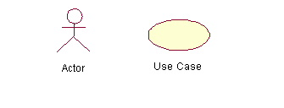
Use Case Diagram (core components)
Actors: A role that a user plays with respect to the system,including human users and other systems. e.g., physical objects (e.g. robot); an external system that needs some information from the current system.
Use case: A set of scenarios that describing an interaction between a user and a system, including alternatives.
System boundary: rectangle diagram representing the boundary between the actors and the system.

Slide 35
Use Case Diagrams
Use Case
Boundary
Actor
Library System
Borrow
Employee
Client
Order Title
Fine Remittance
Supervisor
A generalized description of how a system will be used.
Provides an overview of the intended functionality of the system

Slide 36
Use Case Diagram(core relationship)
Association: communication between an actor and a use case; Represented by a solid line.
Generalization: Generalization relationships are used in use-case diagrams to indicate that the child receives all of the attributes, operations, and relationships that are defined in the parent. Represented by a line with a triangular arrow head toward the parent use case.

Slide 37
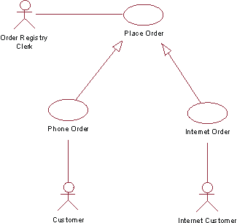

Slide 38
Use Case Diagram(core relationship)
Include:
An include relationship is a relationship in which one use case (the base use case) includes the functionality of another use case (the inclusion use case). The include relationship supports the reuse of functionality in a use-case model. .
a dotted line labeled <<include>> beginning at base use case and ending with an arrows pointing to the include use case.
<<include>>

Slide 39
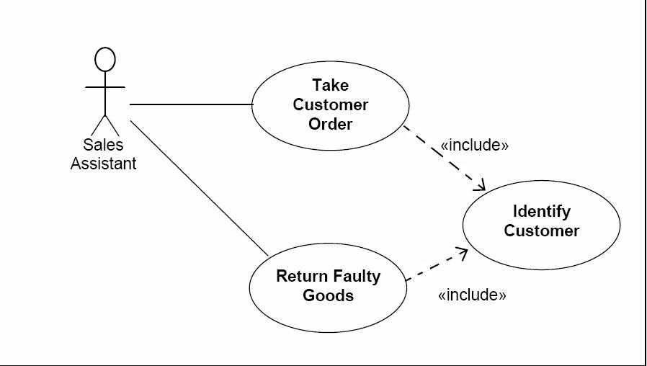
<<Include>> Relationship

Slide 40
<<Extend>> Relationship
In UML modeling, you can use an extend relationship to specify that one use case (extension) extends the behavior of another use case (base)
Extend: a dotted line labeled <<extend>> with an arrow toward the base case. The extending use case may add behavior to the base use case. The base class declares “extension points”.
<<extend>>

Slide 41
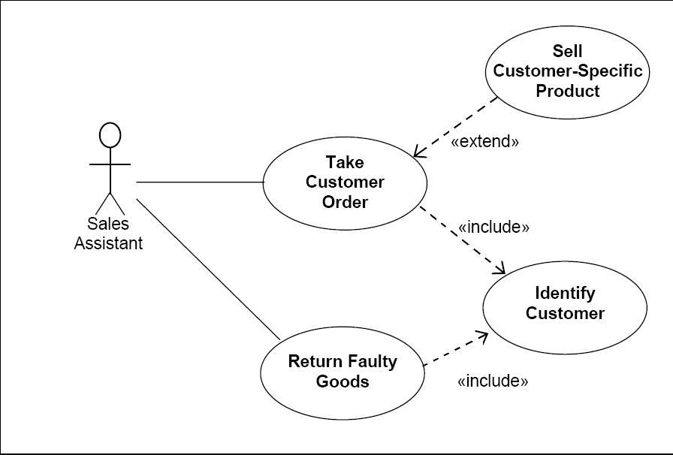
Extend Relationship

Slide 42
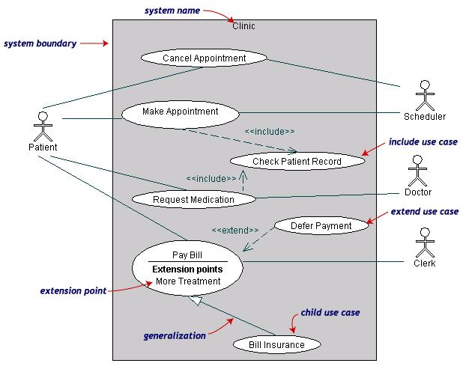
Use Case Diagrams(cont.)
(TogetherSoft, Inc)

Slide 43
Use Case Diagrams(cont.)
Pay Bill is a parent use case and Bill Insurance is the child use case. (generalization)
Both Make Appointment and Request Medication include Check Patient Record as a subtask.(include)
The extension point is written inside the base case Pay bill; the extending class Defer payment adds the behavior of this extension point. (extend)

Slide 44
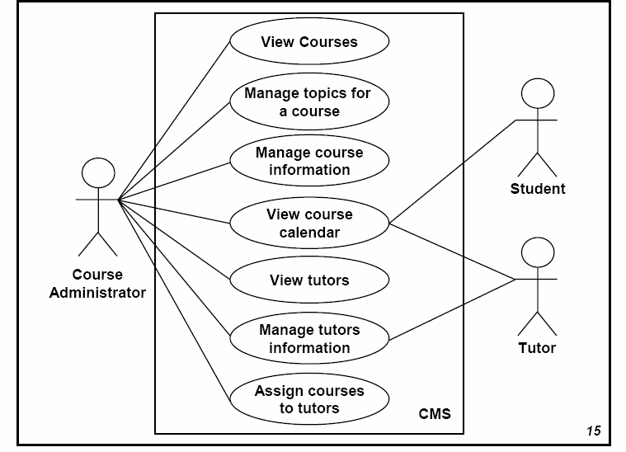

Slide 45
Classes from the Use Case
The following classes are identified:
– Use case actors:
• Course Administrator
• Student
• Tutor
– System objects:
• Course Calendar
• Course
• Topic

Slide 46
Identified Class Operations
The following class operations are identified:
– For Course Administrator, using use cases:
• View courses
• Manage topics for a course
• Manage course information
• View course calendar
• View tutors
• Manage tutor information
• Assign courses to tutors

Slide 47
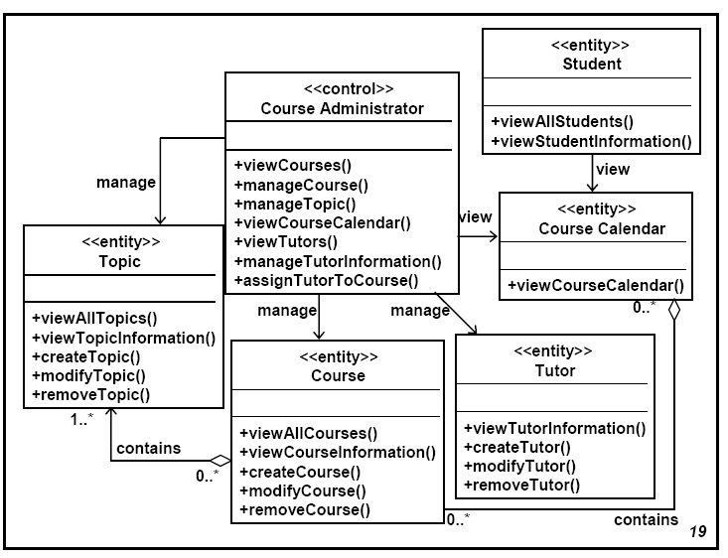

Slide 48
Collaboration Diagram
• Introduction
– Collaboration Diagram places a priority on mapping the object interactions to the object links (drawing the participating objects in an Object diagram format and laying the message parallel to the object link).
– Collaboration Diagram emphasize the effect of the object structures on the interactions.

Slide 49
Collaboration Diagram – Elements
Elements of Collaboration Diagram
– Object
– Link: link between object
– Message
• Send Message
• Return Message
– Condition
• [Condition] Message

Slide 50
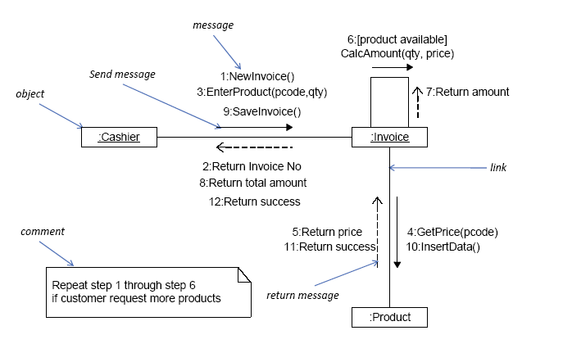
Collaboration Diagram – Elements and Example

Slide 51
State Chart Diagrams in UML
Statechart diagrams describe the dynamic behavior of a system in response to external stimuli.
Statechart diagrams are especially useful in modeling reactive objects whose states are triggered by specific events.

Slide 52
State Chart Diagrams in UML
Use state diagrams to demonstrate the behavior of an object through many use cases of the system.
Only use state diagrams for classes where it is necessary to understand the behavior of the object throughout the entire system.
Not all classes will require a state diagram and state diagrams are not useful for describing the collaboration of all objects in a use case.
State diagrams are combined with other diagrams such as interaction diagrams and activity diagrams.

Slide 53

Basic State chart Diagram Symbols and Notations
States
States represent situations during the life of an object.

Slide 54

Symbols and Notations
Initial State
A filled circle represents the object's initial state.
Final State
A filled circle nested inside another circle represents the object's final state.

Slide 55
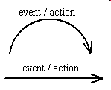
Symbols and Notations
Transition
A solid arrow represents the path between different states of an object. Label the transition with the event that triggered it and the action that results from it

Slide 56
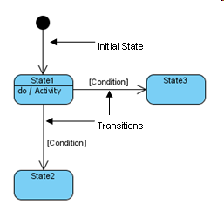

Slide 57
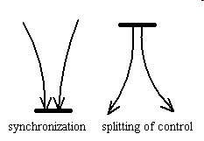
Symbols and Notations
Synchronization and Splitting of Control.
A short heavy bar with two transitions entering it represents a synchronization of control. A short heavy bar with two transitions leaving it represents a splitting of control that creates multiple states.

Slide 58
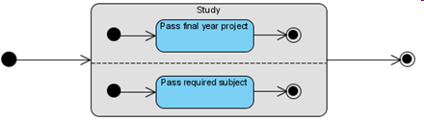
Concurrent State
Sometimes, it is necessary to model several independent abstractions of attribute values. For example, an undergraduate student is required to complete both the final year project and the core subjects before he can graduate.

Slide 59
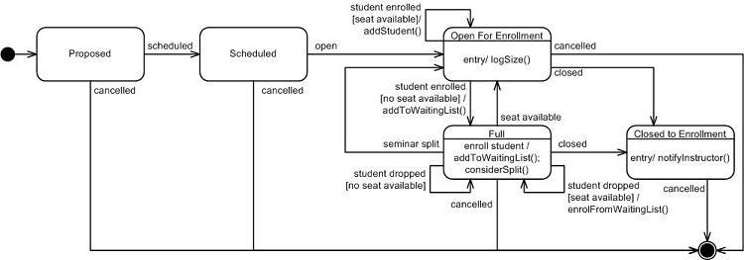
An example state machine diagram for the Seminar class during registration.

Slide 60
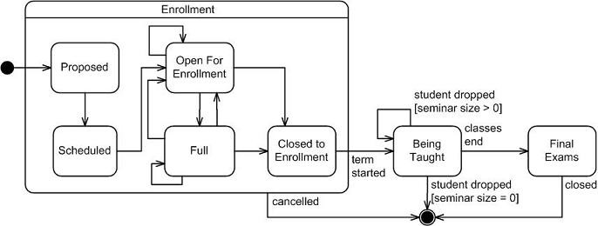
Enrollment is a sub state

